Slide 1
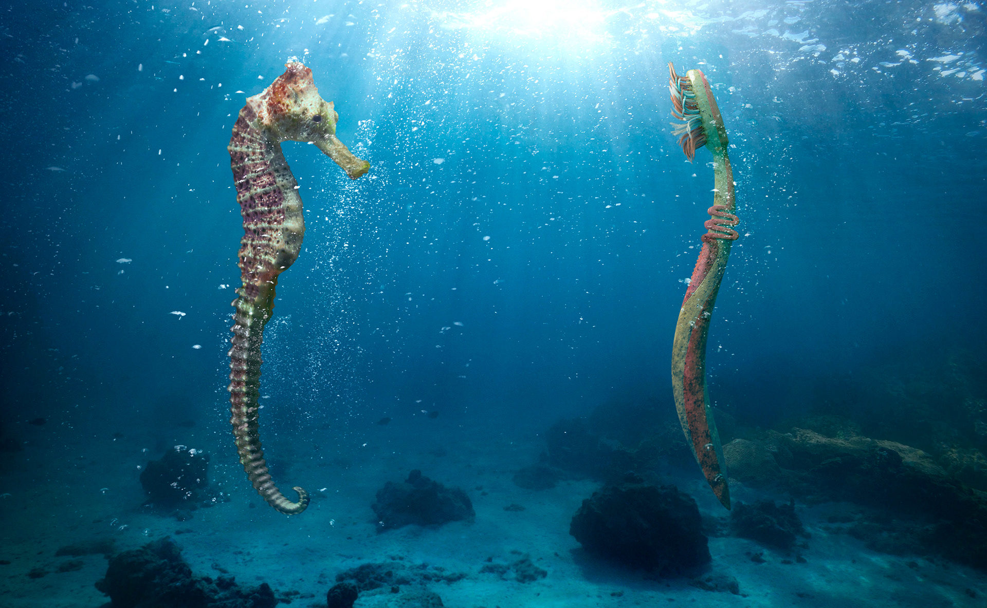

Healthy smiles don't have to cost our planet's health

Slide 2



Problem
Toothbrushes led more than 400 years to decompose, allied to this approximately 70% of people suffer from toothache or inflamed gums
while only 30% have complete permanent teeth!
?
Sustainability
Tooth Care

Slide 3


Slide 4
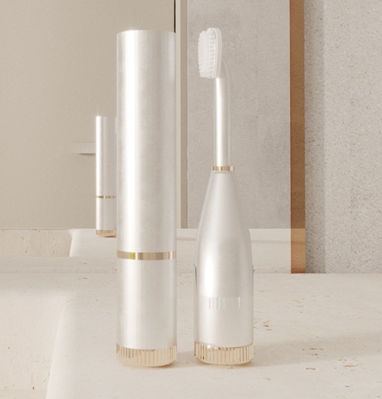



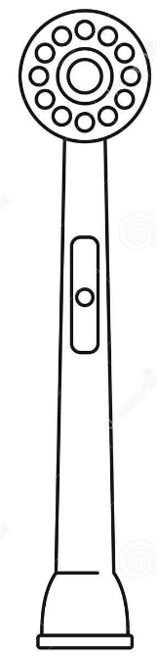
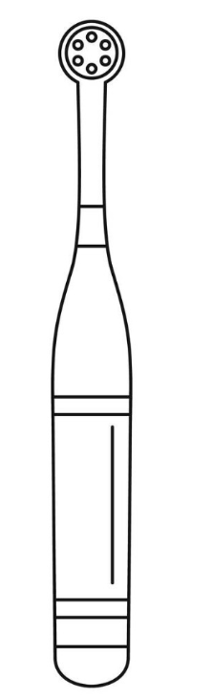


Product
BIOACTIVE PROPERTIES
HIGHER EFFICIENCY
BIODEGRADABLE HEADS
MORE SUSTAINABLE
The solution is a highly durable toothbrush with replaceable heads.
METALLIC BODY
Bioactive Heads
Short-term
Battery-free Toothbrush
Long-term
EXTENDED LIFESPAN
ROTATING MOVEMENT
BATTERY-FREE SYSTEM
SAME CONFORT

Slide 5
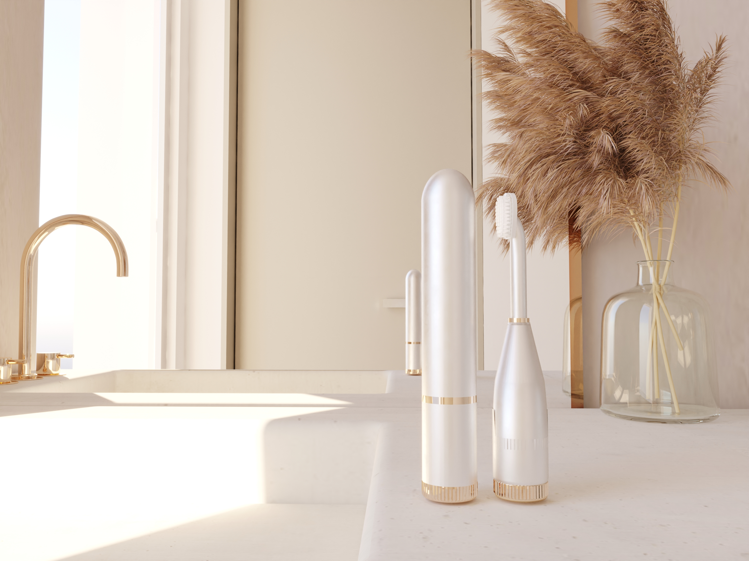
Deal
Bioactive toothbrush heads
Bioactive toothbrush heads
Final Customer
B2C
Large Retail
B2B
€ 9 / unit
€ 450 / 100 units
Notes:
€ 153 / unit Battery-free Toothbrush € 4K / 100 units
InBfusion focuses on selling bioactive and biodegradable heads compatible with toothbrushes of others brands to final costumer and to large retail companies.
We will start with direct sales to the final costumer by online channels considering the price of nine euros per unit. In the future, we want to make our product also available at pharmaceutical and oral care stores with more competitive prices.

Slide 6
Beachhead Market
The costumer profile is characterized by:
1M
€ 6M
Online (EU) 16%*
At least two dental visits per year
75%
2028
At least one professional dental cleaning per year
70%
Large Retail (PT) 58%*
73k
€ 290k
2027
21k
€ 85k
Frequent toothache
65%
Pharmacy (PT) 17%*
2027
20k
€ 80k
Buying sustainable products
11%
Online (PT) 16%*
8k
€ 35k
Tooth sensitivity
33%
2026
Dentist (PT) 7%*
2025
* Percentages resulting from consumers' preference for purchasing our product based on a survey carried out with more than 1000 people in Portugal.
Notes:
In an electric toothbrush market with a growth rate of 3.9% in the next years, we identified our beachhead market, as the people suffering from tooth sensitivity and concerned with sustainability.
We will start focusing on Portuguese market by selling online and large retail. After consolidating our position, we expect to enter in the European market, in two thousand twenty-eight.

Slide 7
Customer value proposition
Sustainability
Tooth Sensitivity
Average number of years for toothbrush heads to degrade
Average number of days reporting sensitivity after treatment with professional use products
Other brands
400 Y
62 %
Other brands
2Y
39 %
Years
% people with tooth sensitivity*
* Scientific studies performed considering the bioactive agent not incorporated on bristles.

Slide 8
Financials
2028
Bioactive heads
Battery-free Toothbrush
Net Price/Product
€ 9 *
Profit/Product
€ 4
Profit/year
€ 101 456
Cost/Product
€ 5
Profit/year
€ 622 164
Market
1 491 999
Customers
74 600
Products/Year
149 200
Market Share
5 %
Products/Customer/Year
2
Key Drivers
Price of Product
Production cost
Market share
* € 9 value estimated based on the budgets provided by the suppliers (cost of materials; cost of injection molding; human resources; sales efforts).
Notes:
Here it is represented the financial analysis for universal bioactive heads. Considering our beachhed market mentioned previously, and a market share of five percent, we expect obtain more than half million euros profit per year and 4 € profit per product.

Slide 9






Competitive Advantages
Premium Quality
Low Cost
Environmental awareness
General efficacy
Notes:
Based on our competitive advantages we stand out from other toothbrush brands

Slide 10

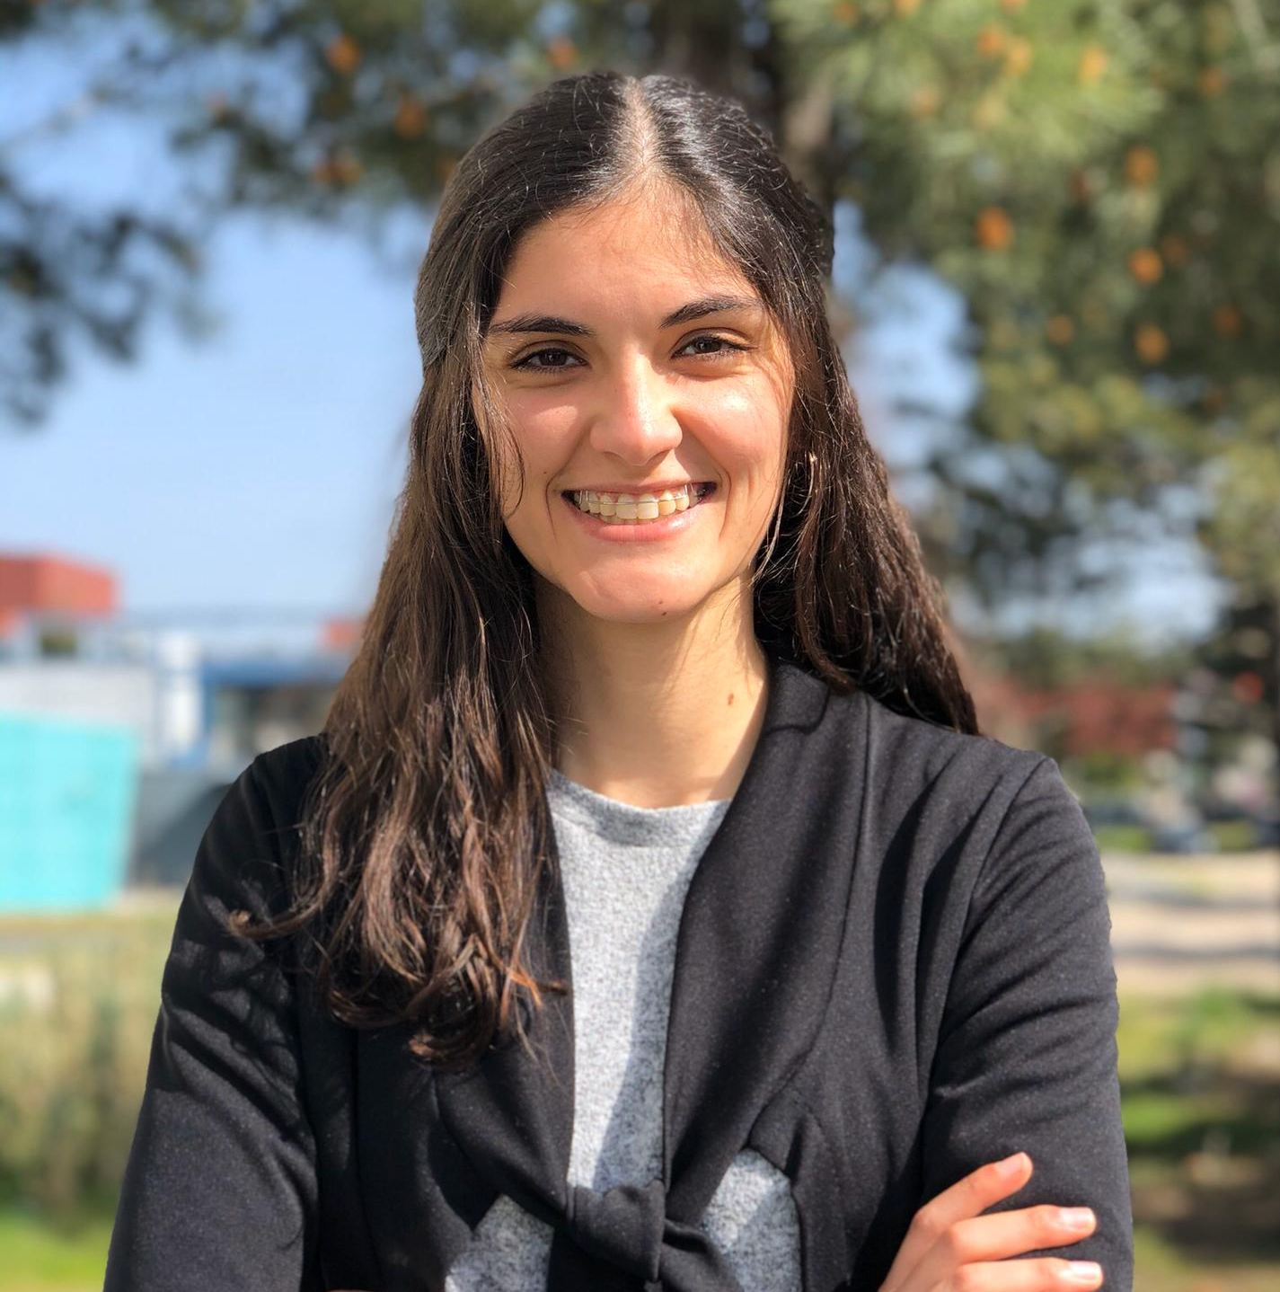
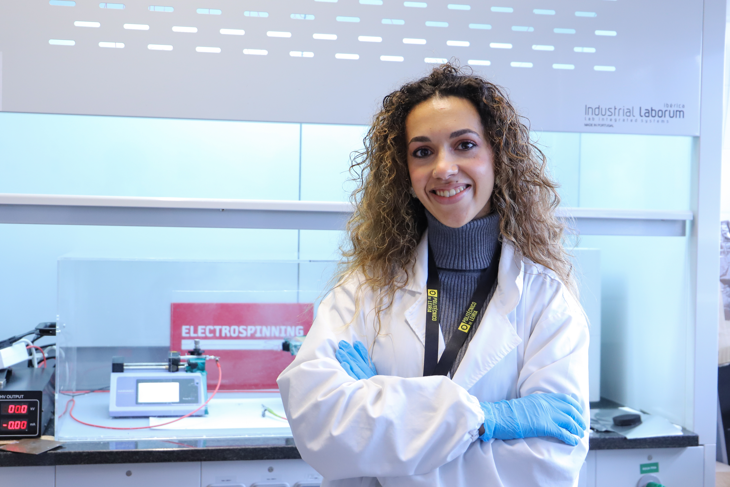
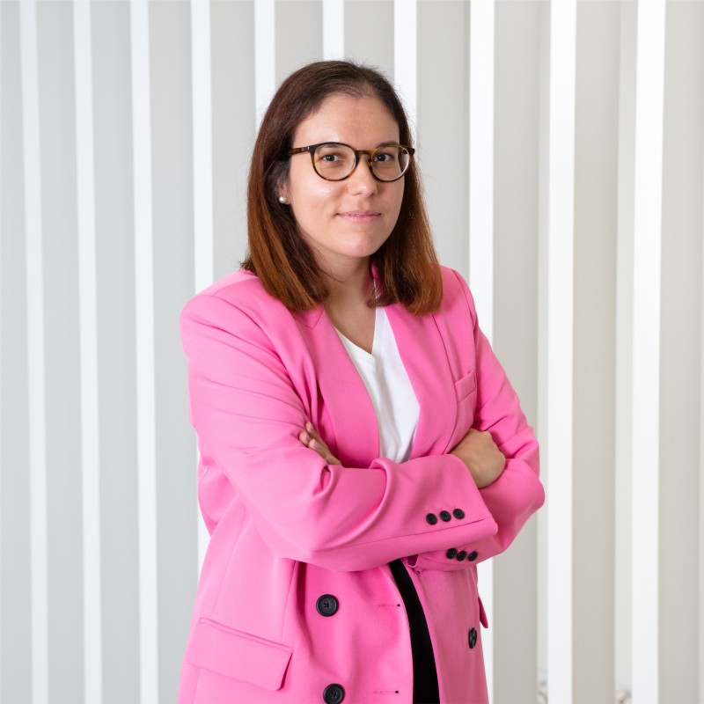
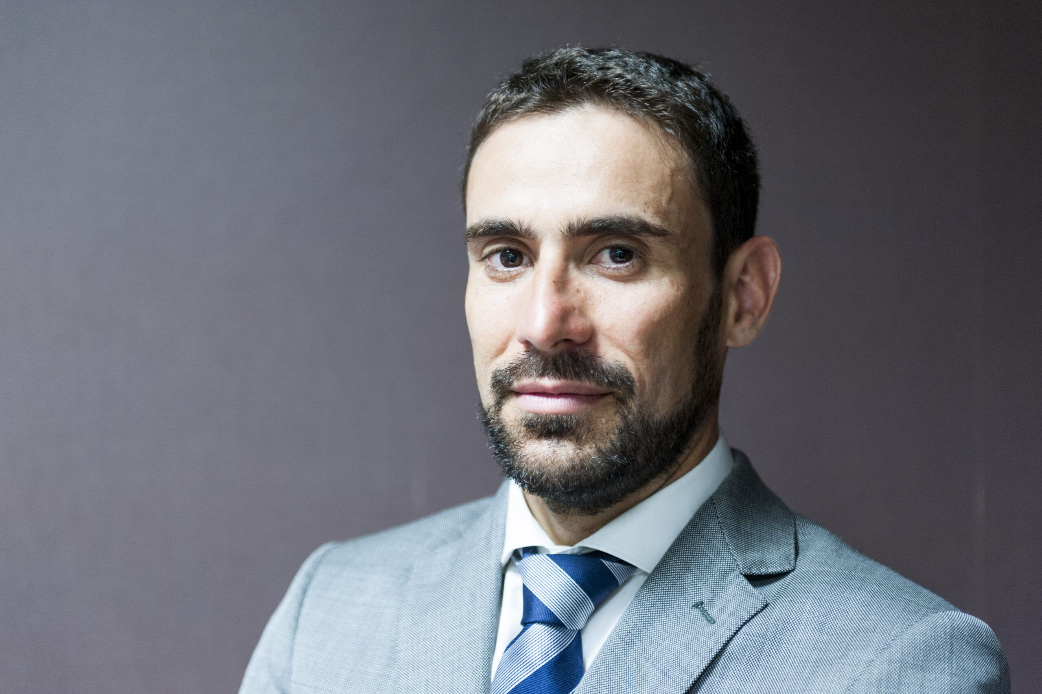
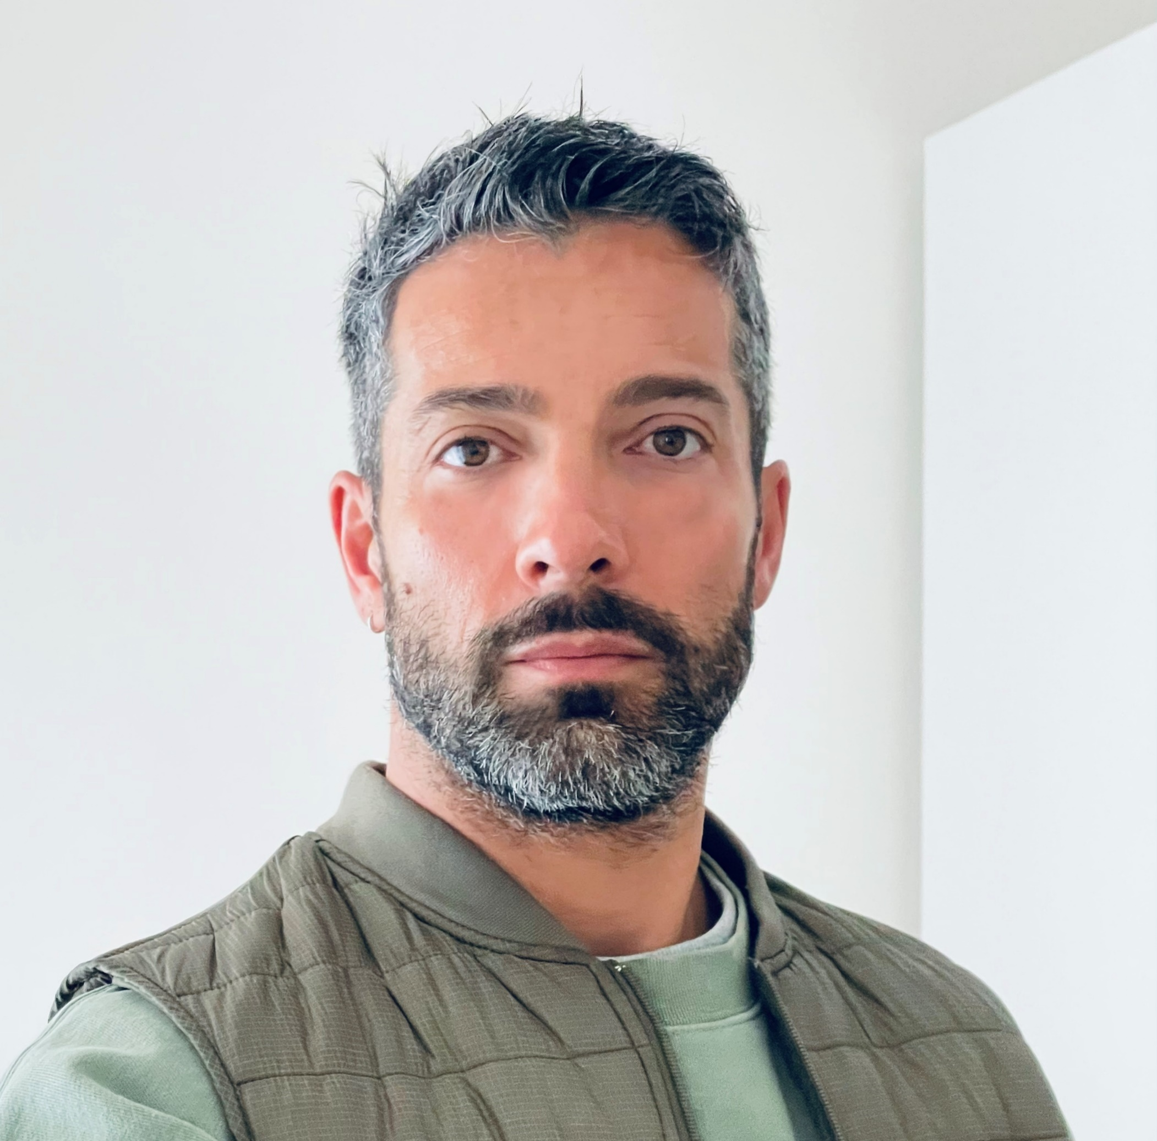
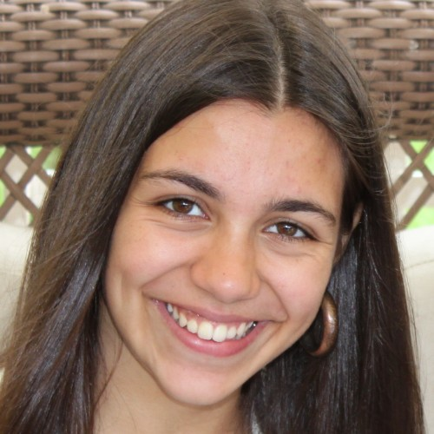
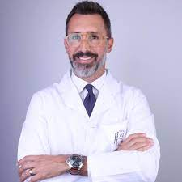




Team
Tatiana Padrão General Manager & Co-Founder
Metallurgical & Materials Eng.
PhD Student
Sara Guerreiro Financial & Co-Founder
Biomedical Eng.
PhD Student
Carolina Ferreira R&D & Co-Founder
Biotechnology
PhD Student
Catarina Coelho Commun. & Strategy
+10Y in Healthcare Industry
PhD
Advisors
Ecosystem
Vitor Ferreira Business
Startup Leiria
Pedro Ricardo Branding
Freelancer
Maria J Padrão Product design
Freelancer
Pedro C. Monteiro
Clinical
MD

Slide 11
Founders’ Dream
Achievements
Demo Day Startup Leiria
Best pitch
HEICE Competition
2023
2022
Finalist
EIT Jumpstarter
EIT Climate Launchpad
To go to market (online)
Poliempreende Regional Competition
1st prize
2023
2022
Production of 5000 un. heads
Development of innovative bristles
Business plan & STARTUP creation
2026
2025
Idea & brainstorming
2024
2023
2022

Slide 12
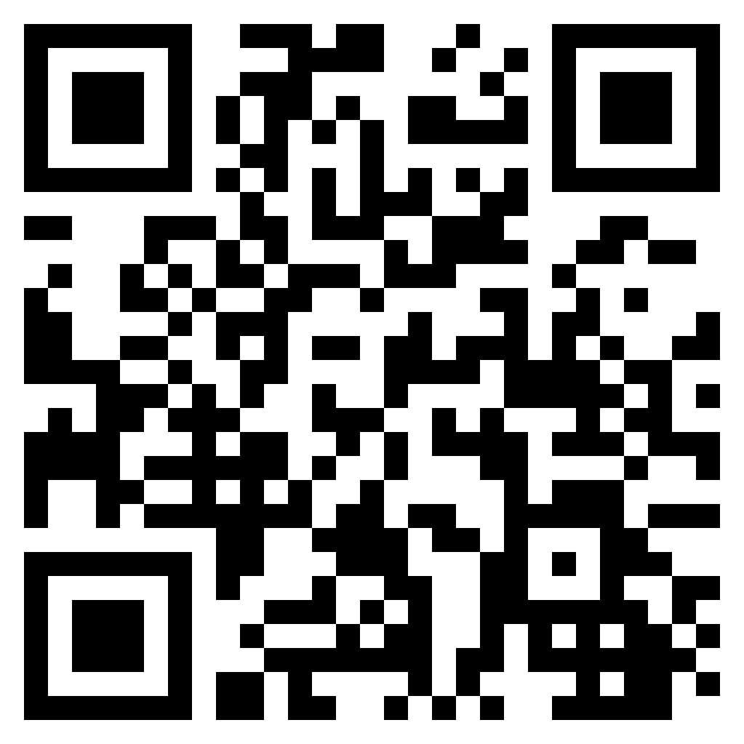




CONTACTS
Healthy smiles don't have to cost our planet's health
www.inbfusion.pt
inbfusion@inbfusion.pt
+351 919 464 264

